Slide 1
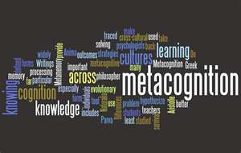
Teaching Students How to Learn:
Metacognition is the Key!
Saundra Yancy McGuire, Ph.D.
Alumna, Southern Univ Dept of Chemistry
(Ret) Assistant Vice Chancellor and Professor of Chemistry, LSU
Director Emerita, Center for Academic Success
AAAS, ACS, CLADEA Fellow

Slide 2

Are HBCUs Still Relevant?
HOW

Slide 3
Are HBCUs Still Relevant?*
HOW
HBCUs are still havens for the disadvantaged
HBCUs are blazing STEM trails
HBCUs make college more affordable
HBCUs serve the community and the nation with alumni like Senator Kamala Harris!
*http://www.theedadvocate.org/5-reasons-hbcus-are-still-relevant/

Slide 4

Mission Statement
Lincoln University, the nation’s first degree-granting Historically Black College and University (HBCU), educates and empowers students to lead their communities and change the world.
It does so by:
Providing a rigorous liberal arts education featuring active and collaborative learning;
Integrating academic and co-curricular programs with the University’s distinctive legacy of global engagement, social responsibility and leadership development;
Cultivating the character, values and standards of excellence needed to enable students to become responsible citizens of a global community.

Slide 5
Vision Statement
Lincoln University will be a national model for both 21st century liberal arts undergraduate education and innovative graduate and professional programs.
REIMAGINING THE LEGACY:
LEARN. LIBERATE. LEAD

Slide 6



Lincoln University Accolades
Top 20 Best HBCUs
Top 40 for
Social Mobility
Top 10 Best Value HBCU

Slide 7
Notable Lincoln University Alumni
  Ghanaian President Kwame Nkrumah
  Supreme Court Justice Thurgood Marshall
  Rear Admiral Lillian E Fishburne
  Monte Irvin, Baseball Hall of Fame Inductee
  Lt. Governor Sheila Oliver, New Jersey
  Langston Hughes, poet, activist, novelist, playwright
  Microbiology Professor Hildrus Augustus Poindexter, M.D., M.P.H., Ph.D., D.Sc.

Slide 8
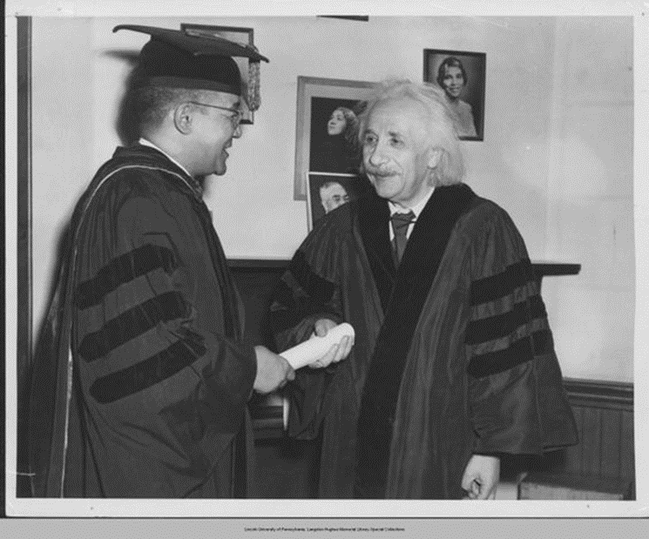

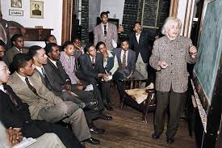
Another Famous Lincoln Degree Recipient
Dr. Horace Mann Bond, President of Lincoln University, confers an honorary doctoral degree upon Dr. Albert Einstein on May 3, 1946
Einstein lecturing to Lincoln
students on his theory of relativity
Jerome, F., & Taylor, R. (2005). Einstein
on Race and Racism. New Brunswick: Rutgers University Press.

Slide 9

National Institute of Science
Founded at Lincoln University in 1923
Dr. Harold F. Grim – Biology
Dr. Arthur E. James – Chemistry
Dr. Walter L. Wright – Mathematics
Hildrus Augustus Poindexter
+ 23 other students

Slide 10
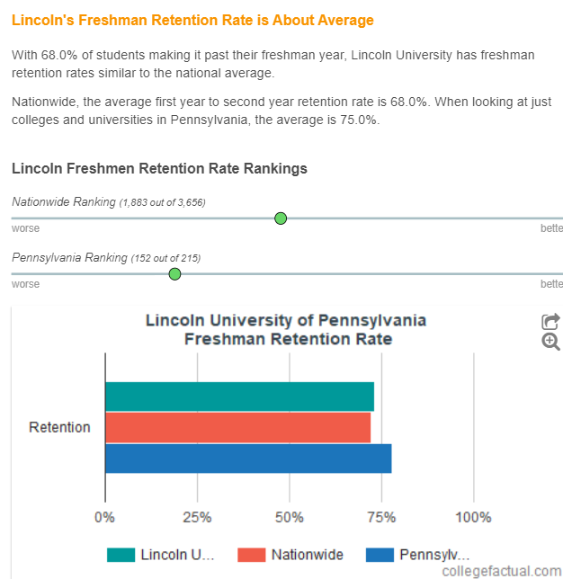
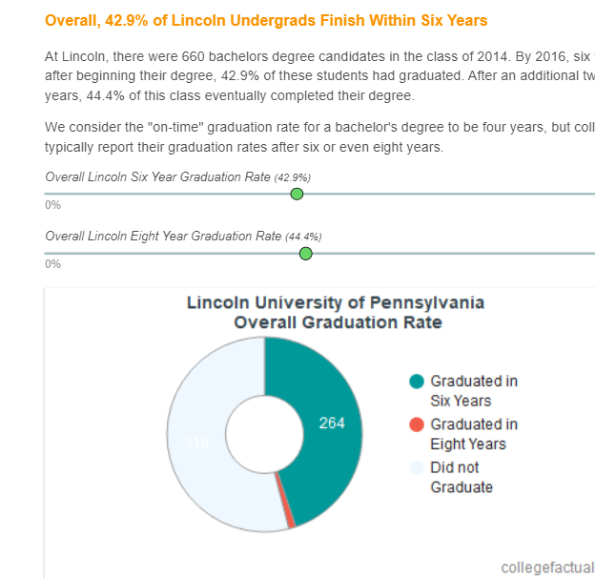
Lincoln University
Retention and Graduation Rates
Lincoln U Retention Rate is 68.0%*
National Average is 68.0%
Pennsylvania Average is 75.0%
Lincoln U Six-Year Grad Rate is 42.9%*
National Average is 47.6%
Expected Lincoln U Grad Rate is 33.5%
https://www.collegefactual.com/colleges/lincoln-university-of-pennsylvania/academic-life/graduation-and-retention/

Slide 11
How Can Lincoln University
Improve These Rates?
Teach Students How to Learn
Help Students Develop a Growth Mindset About Intelligence
Motivate Students to Implement Effective Learning Strategies

Slide 12
Metacognition
The ability to:
think about your own thinking
be consciously aware of yourself as a problem solver
monitor, plan, and control your mental processing (e.g. “Am I understanding this material, or just memorizing it?”)
accurately judge your level of learning
know what you know and what you don’t know
Flavell, J. H. (1976). Metacognitive aspects of problem solving. In L. B. Resnick (Ed.), The nature of intelligence (pp.231-236). Hillsdale, NJ: Erlbaum

Slide 13


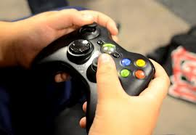
Why haven’t most students developed metacognitive skills?
It wasn’t necessary before

Slide 14
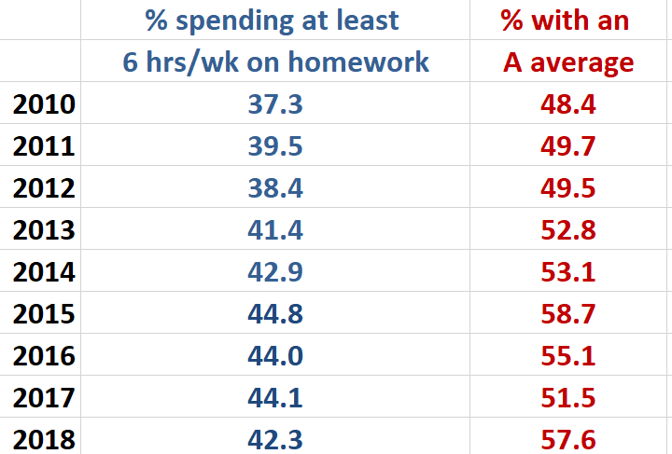
Data from UCLA Higher Education Research Institute (HERI)
First Year Student Survey – 2010 - 2018
www.heri.ucla.edu

Slide 15
What did most of your teachers in high school do the day before the test?
How do you think most students
would answer the following?
What did they do during this activity?
What grade would you have made on the test if you had gone to class only
on the day before the test?

Slide 16
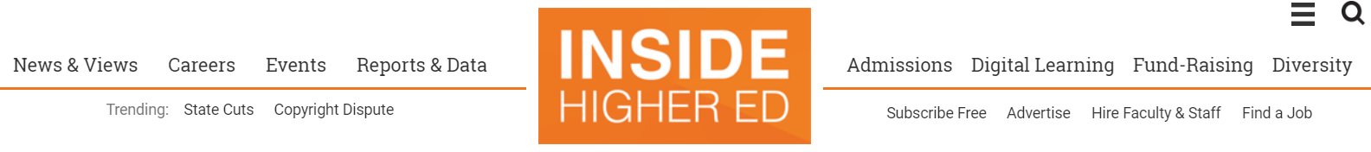
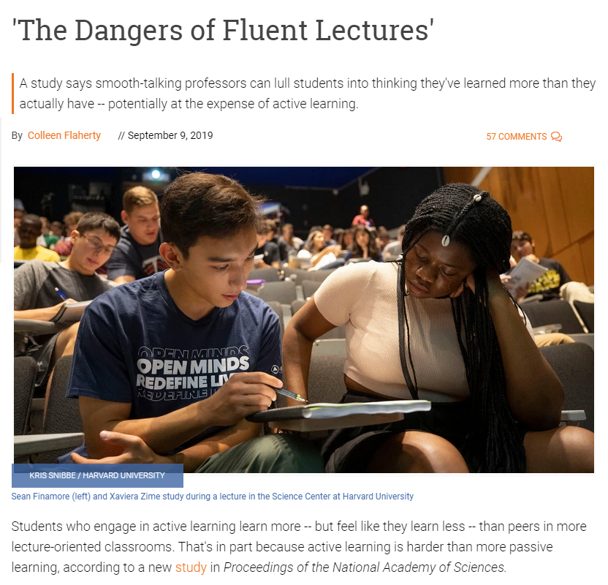
How Do Students Feel About Active Learning?

Slide 17

Faculty Must Help Students Make the Transition
Help students identify and close “the gap”
current behavior current learning
(and grades)
productive behavior desired learning (and grades)

Slide 18
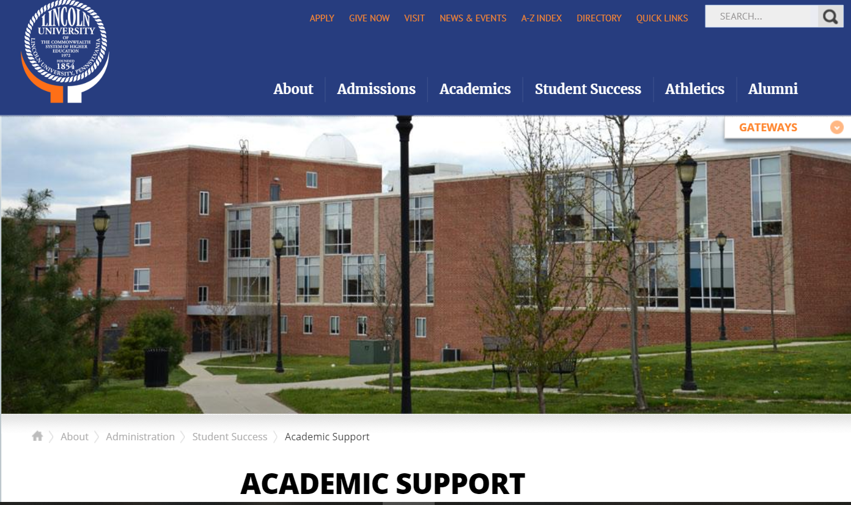
An Invaluable Partner for Lincoln University Faculty

Slide 19
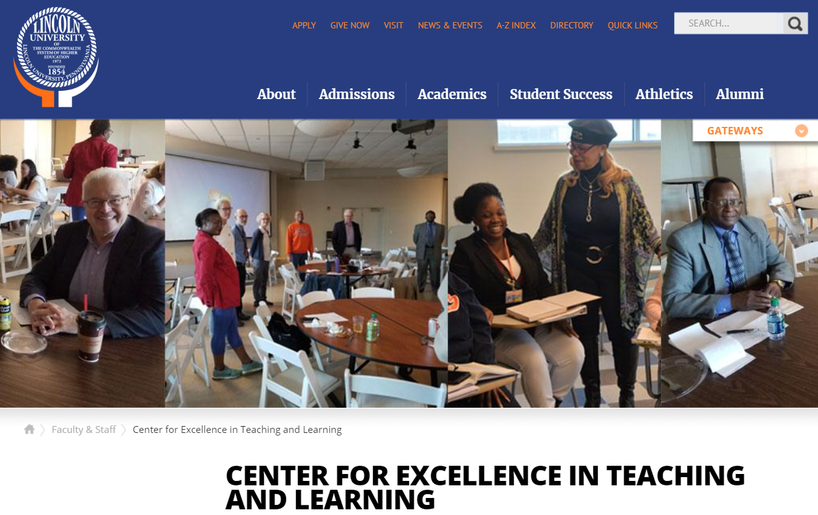
An Invaluable Resource for Lincoln University Faculty

Slide 20
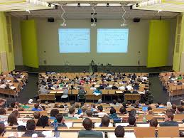
Power of Metacognitive Learning Strategies
Sydnie’s Story: Intro and emails
First encounter on September 23, 2013
Email on October 14, 2013
Email on January 9, 2014
Email on May 7, 2014
Update on July 26, 2016 Cum GPA 3.5
Email on February 7, 2017 Cum GPA 3.6
Sem GPA 4.18

Slide 21
Effective Homework Strategy
Study material first, before looking at the problems/questions
Work example problems (without looking at the solutions) until you get to the answer
Check to see if answer is correct
If answer is not correct, figure out where mistake was made, without consulting solution
Work homework problems/answer questions as if taking a test

Slide 22
Impact of Using Homework Strategy
Sydnie L.
First Year Biology Pre-Med Honors College Student
Email on January 20, 2014
I started to use the "Get more out of your homework" method. I reviewed my notes right before attempting my homework problems, and tried to work the problems without help from the solutions manual or tutors. If I still could not get the right answer, I'd look at my notes again to get a hint, but not to study the problem and mimic it step by step…

Slide 23
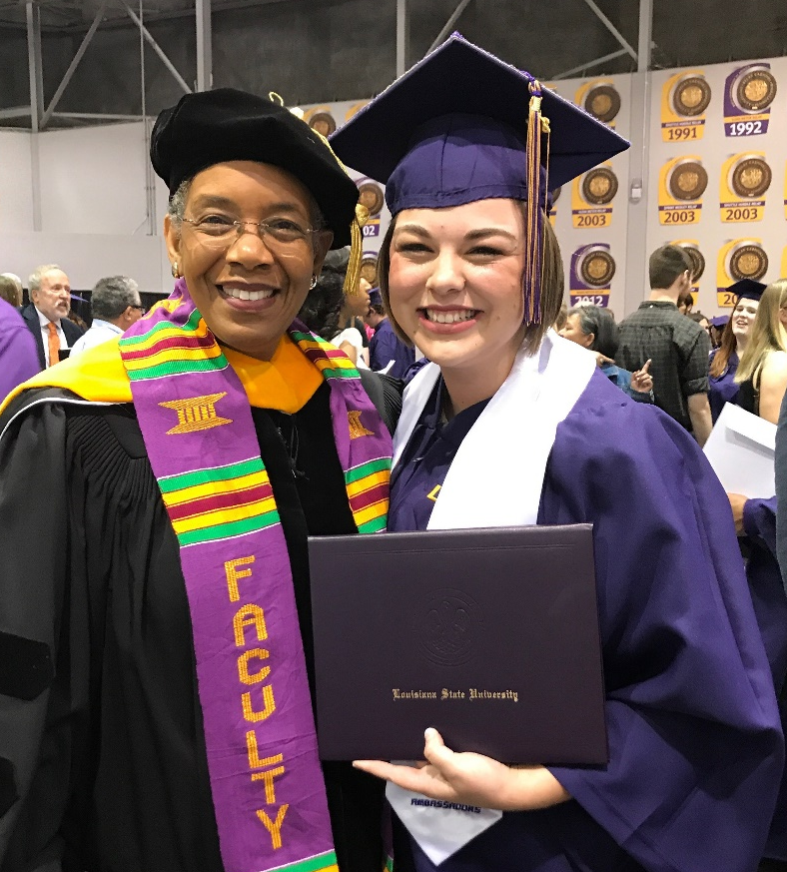
Sydnie Landry, BS in Biology, May 2017
Louisiana State University
Final Semester GPA: 3.77

Slide 24
The Story of Two More Students
Travis, junior psychology student
47, 52, 82, 86 B in course
Dana, first year physics student
80, 54, 91, 97, 90 (final) A in course

Slide 25
A Reading Strategy that Works: SQ5R
Survey (look at intro, summary, bold print, italicized words, etc.)
Question (devise questions survey that you think the reading will answer)
Read (one paragraph at a time)
Recite (summarize in your own words)
Record or wRite (annotate in margins)
Review (summarize the information in your words)
Reflect (other views, remaining questions)

Slide 26
Travis, junior psychology student
47, 52, 82, 86
Problem: Reading Comprehension
Solution: Preview text before reading*
Develop questions*
Read one paragraph at a time
and paraphrase information
* Developing an anticipatory set

Slide 27
First Voyage of Christopher Columbus
WITH HOCKED GEMS FINANCING HIM/ OUR HERO BRAVELY DEFIED ALL SCORNFUL LAUGHTER/ THAT TRIED TO PREVENT HIS SCHEME/ YOUR EYES DECEIVE/ HE HAD SAID/ AN EGG/ NOT A TABLE/ CORRECTLY TYPIFIES THIS UNEXPLORED PLANET/ NOW THREE STURDY SISTERS SOUGHT PROOF/ FORGING ALONG SOMETIMES THROUGH CALM VASTNESS/ YET MORE OFTEN OVER TURBULENT PEAKS AND VALLEYS/ DAYS BECAME WEEKS/ AS MANY DOUBTERS SPREAD FEARFUL RUMORS ABOUT THE EDGE/ AT LAST/ FROM NOWHERE/ WELCOME WINGED CREATURES APPEARED/ SIGNIFYING MOMENTOUS SUCCESS
Dooling, J.D. and Lachman, R. Effects of Comprehension on Retention of Prose, Journal of Experimental Psychology, (1971), Vol. 88, No. 2, 216-222

Slide 28
Reflection Questions
What’s the difference, if any, between studying and learning?
For which task would you work harder?
A. Make an A on the test
B. Teach the material to the class

Slide 29
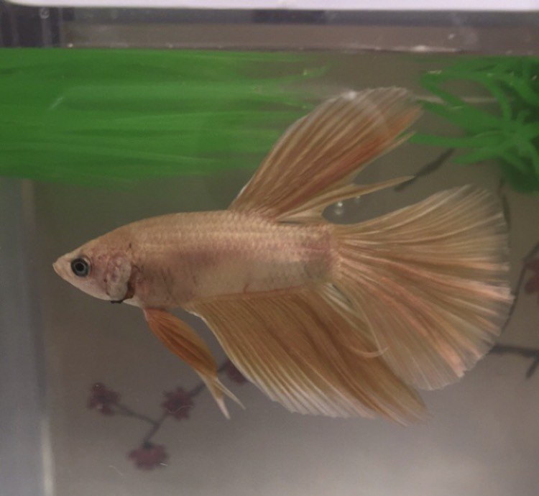
The Power of Teaching to Learn:
What Happened When Ty Taught His Betta Fish
First encounter on September 17, 2018
Email on October 25, 2018
Bio Exam Grades: 66, 98, 90; Final Grade B
Chem Exam Grades: 62, 83; Final Grade B

Slide 30
Impact of Teaching to Learn
Ty, LSU First Year Student
Email Received on October 26, 2018
I attended more of the Supplemental Instruction (SI) sessions and the exam reviews. Before the exam reviews and SI Sessions I would try to answer as many of the questions as possible to see about where I was in terms of grasping the information, then at the exam reviews/SI sessions I would know what I needed to understand. Next after the reviews/SI sessions I would go to my room and “teach” the materials to my betta fish. The material I couldn’t explain, I would study more. I would continue that cycle until I could explain everything in my notes....

Slide 31
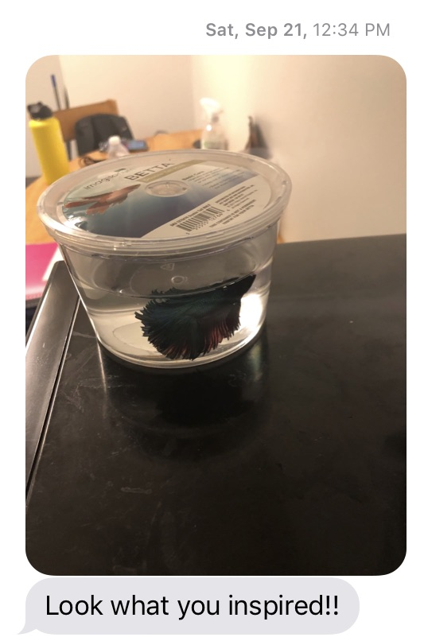
Betta fish purchased on September 21, 2019 by Howard University Bison STEM Scholars

Slide 32



Why Is Fast and Dramatic
Improvement Possible?
It’s all about the strategies, and getting them to engage their brains!

Slide 33
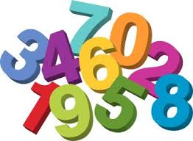
Finding Numbers in Sequential Order
How many can you find in
15 seconds?

Slide 34

Center for Academic Success

Slide 35
What was the major difference between the first attempt
and the second attempt?
We knew how the information
was organized

Slide 36
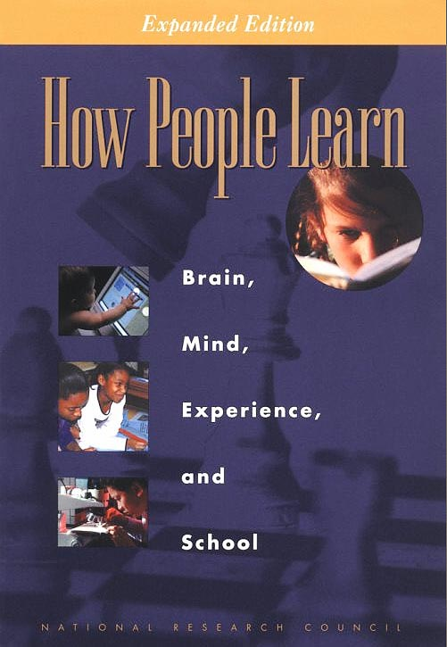
Bransford, J.D., Brown, A.L., Cocking, R.R. (Eds.), 2000. How people learn: Brain, Mind, Experience, and School. Washington, DC: National Academy Press.

Slide 37
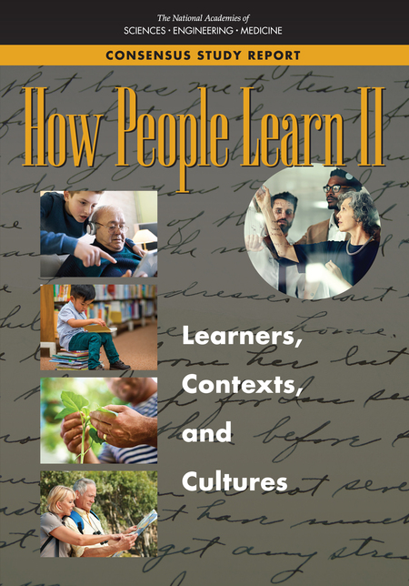
National Academies of Sciences, Engineering, and Medicine. 2018. How People Learn II: Learners, Contexts, and Cultures. Washington, DC: The National Academies Press. https://doi.org/10.17226/24783

Slide 38
What we know about learning
Active learning is more lasting than passive learning
-- Passive learning is an oxymoron*
Thinking about thinking is important
  Metacognition**
The level at which learning occurs is important
  Bloom’s Taxonomy***
  *Cross, Patricia, “Opening Windows on Learning” League for Innovation in the Community College, June 1998, p. 21.
** Flavell, John, “Metacognition and cognitive monitoring: A new area of cognitive–developmental inquiry.” American Psychologist, Vol 34(10), Oct 1979, 906-911.
*** Bloom Benjamin. S. (1956). Taxonomy of Educational Objectives, Handbook I: The Cognitive Domain. New York: David McKay Co Inc.

Slide 39
Bloom’s Taxonomy
Creating
Putting elements together to form a coherent or functional whole
Making judgments based on criteria and standards through checking and critiquing
Evaluating
Analyzing
Breaking material into constituent parts
Carrying out or using a procedure through executing, or implementing
Applying
Constructing meaning from oral, written, and graphic messages
Understanding
Retrieving, recognizing, and recalling relevant knowledge from
long-term memory
Remembering
http://www.lsu.edu/students/casmakebettergrades/successresources/CAS_Blooms.pdf

Slide 40
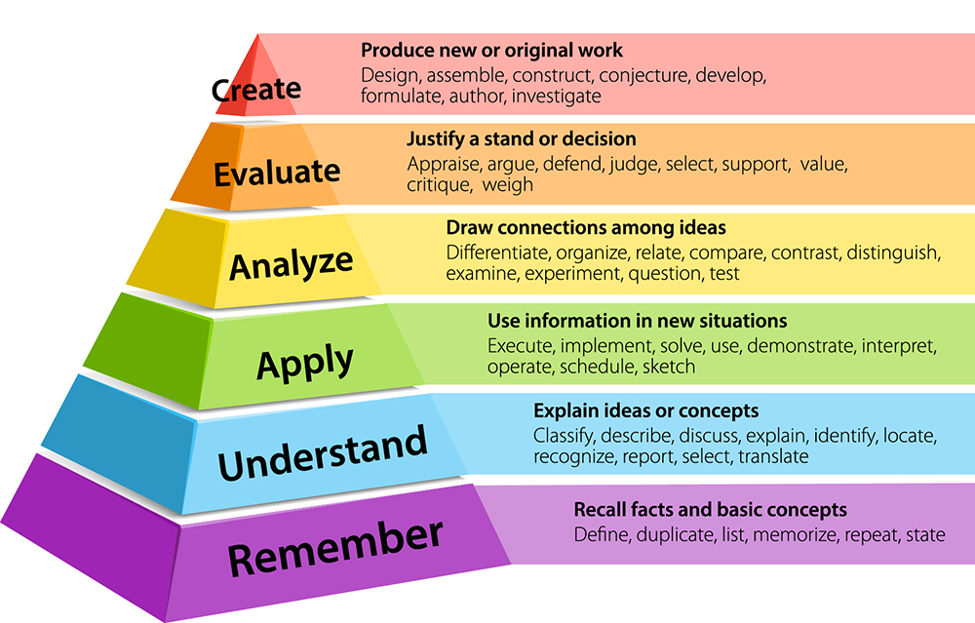
Bloom’s Taxonomy
https://www.krausanderson.com/wp-content/uploads/2016/09/Bloom.jpg

Slide 41

When we teach students about Bloom’s Taxonomy…
They GET it!

Slide 42
How do you think students answered?
At what level of Bloom’s did you have to operate to make A’s or B’s in high school?
Remembering
Understanding
Applying
Analyzing
Evaluating
Creating

Slide 43
How do you think students answered?
At what level of Bloom’s do you think you’ll need to operate to make A’s in college courses?
Remembering
Understanding
Applying
Analyzing
Evaluating
Creating

Slide 44

At what level of Bloom’s did you have to operate to make A’s or B’s in high school?
How students answered (2013)
Remembering
Understanding
Applying
Analyzing
Evaluating
Creating

Slide 45
How students answered (in 2013)
At what level of Bloom’s do you think you’ll need to operate to make A’s in college?
Remembering
Understanding
Applying
Analyzing
Evaluating
Creating

Slide 46
At what level of Bloom’s did you have to operate to make A’s and B’s in high school?
How students answered (2014)
Remembering
Understanding
Applying
Analyzing
Evaluating
Creating

Slide 47
At what level of Bloom’s do you think you’ll need to operate to make A’s in college?
How students answered (in 2014)
Remembering
Understanding
Applying
Analyzing
Evaluating
Creating

Slide 48
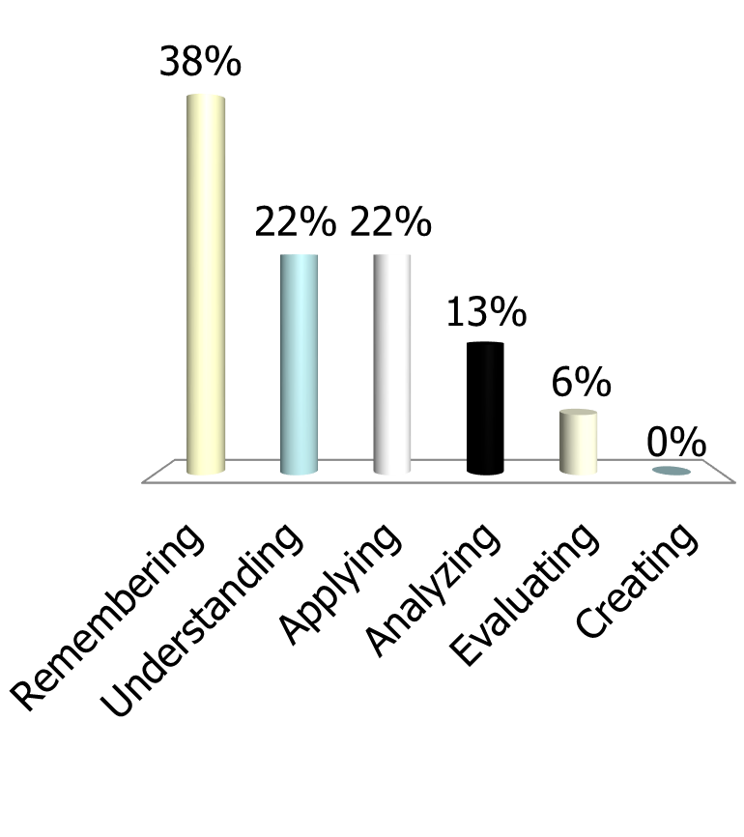
At what level of Bloom’s did you have to operate to make A’s and B’s in high school?
How students answered (2017)
Remembering
Understanding
Applying
Analyzing
Evaluating
Creating

Slide 49
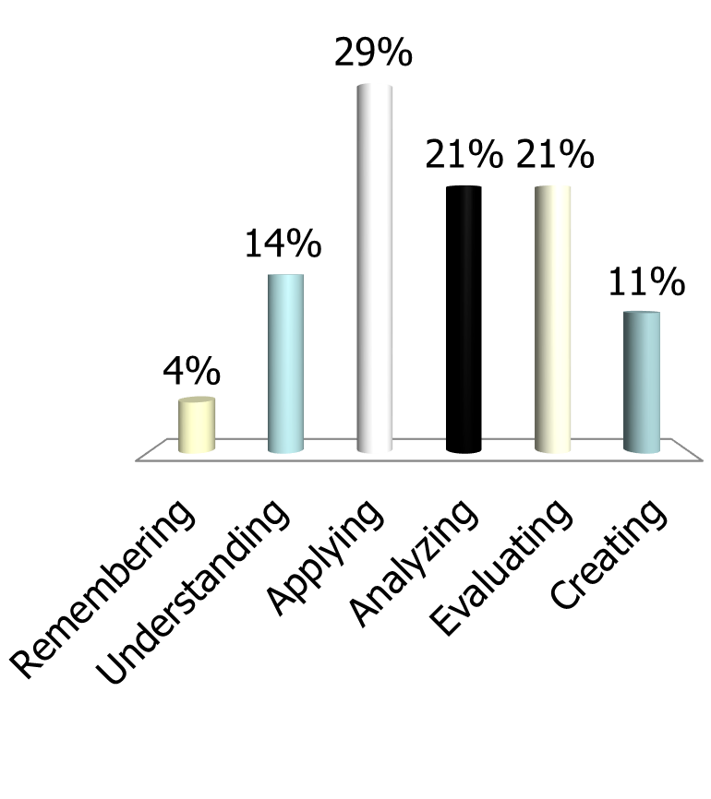
At what level of Bloom’s do you think you’ll need to operate to make A’s in college?
How students answered (in 2017)
Remembering
Understanding
Applying
Analyzing
Evaluating
Creating

Slide 50
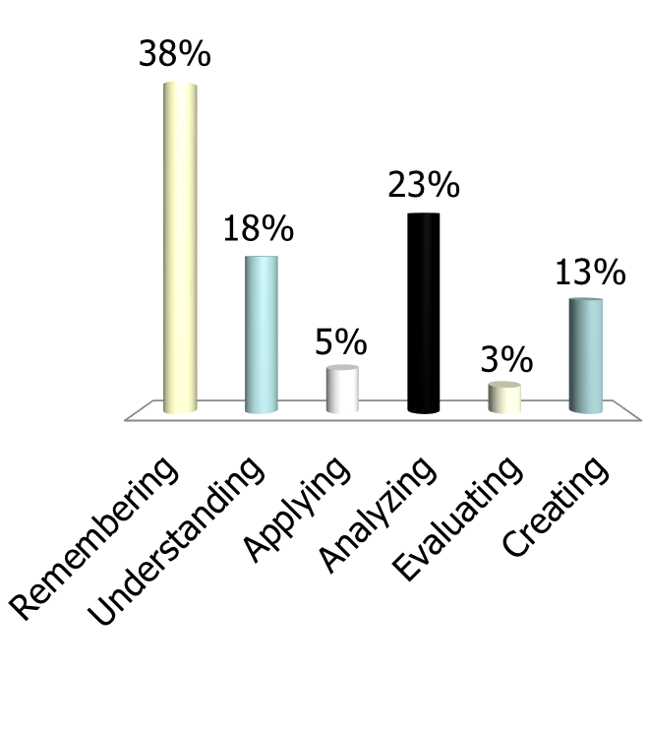
At what level of Bloom’s do you think you’ll need to operate to make A’s and B’s in high school?
How students answered (in 2018)
Remembering
Understanding
Applying
Analyzing
Evaluating
Creating

Slide 51
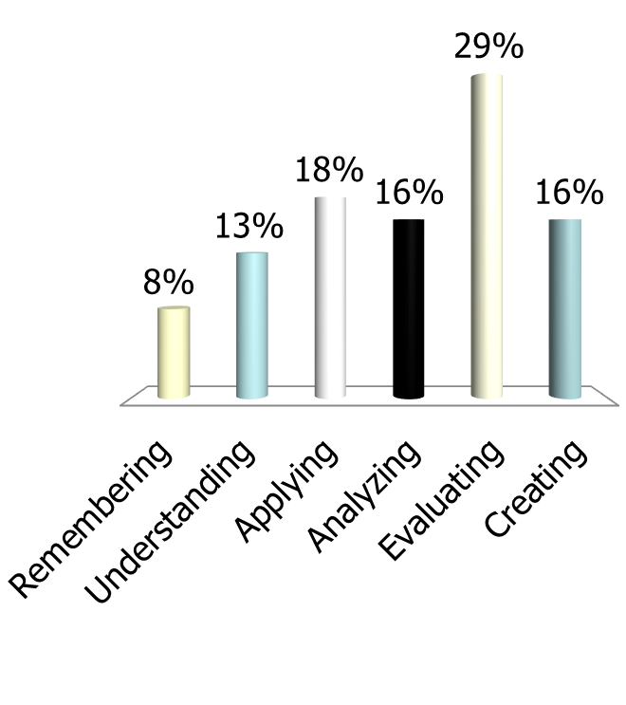
At what level of Bloom’s do you think you’ll need to operate to make A’s in college?
How students answered (in 2018)
Remembering
Understanding
Applying
Analyzing
Evaluating
Creating

Slide 52
How do we teach students to move higher on Bloom’s Taxonomy?
Teach them the Study Cycle*
*adapted from Frank Christ’s PLRS system

Slide 53

The Study Cycle
4
Reflect
3
Review
4
Reflect
Preview
Preview before class – Skim the chapter, note headings and boldface words, review summaries and chapter objectives, and come up with questions you’d like the lecture to answer for you.
Attend
Attend class – GO TO CLASS! Answer and ask questions and take meaningful notes.
Review
Review after class – As soon after class as possible, read notes, fill in gaps and note any questions.
Study
Study – Repetition is the key. Ask questions such as ‘why’, ‘how’, and ‘what if’.
Intense Study Sessions* - 3-5 short study sessions per day
Weekend Review – Read notes and material from the week to make connections
Assess
Assess your Learning – Periodically perform reality checks
Am I using study methods that are effective?
Do I understand the material enough to teach it to others?
Focused Study Sessions
1 | Set a Goal | 1-2 min | Decide what you want to accomplish in your study session
2 | Study with Focus | 30-50 min | Interact with material- organize, concept map, summarize, process, re-read, fill-in notes, reflect, etc.
3 | Reward Yourself | 10-15 min | Take a break– call a friend, play a short game, get a snack
4 | Review | 5 min | Go over what you just studied
Center for Academic Success
B-31 Coates Hall ▪ 225.578.2872 ▪www.cas.lsu.edu

Slide 54
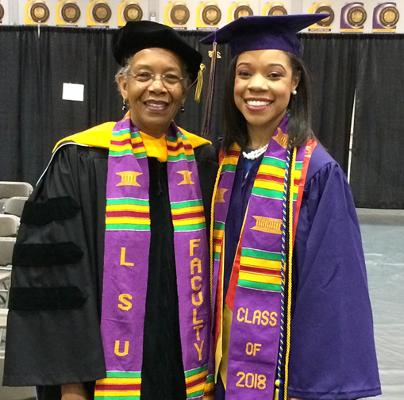
Brea Manuel*, BS in Chemistry, 2018
Entered PhD Program at
Emory University on Full Fellowship in Fall 2018
Became a PhD Candidate Spring 2020!
The intense (focused) study sessions helped me most. I actually got A+ on 3 out of 4 of my finals using that method of studying. It’s important to use it everyday before finals week, and I think it would really benefit students during finals week.
*Manuel, B.A., Karloff, D.B. Recruit and retain a diverse workforce. Nat Rev Chem (2020). https://doi.org/10.1038/s41570-020-0214-z

Slide 55
Sharing Bloom’s and The Study Cycle Improved Learning
Dr. Kelter:
After the ND-Gateway workshop this August, I shared Dr. McGuire’s presentation with several of my colleagues and students in the ABEN department.
One ABEN student was struggling in his classes. I asked how he studied, and found he didn’t have good study habits. I shared the PPT with him on August 21, 2018, and also emphasized the content in slide 32 (Bloom’s Taxonomy) and slide 45 (Study Cycle). He wrote me an email today (September 7, 2018) and said:
“I actually am applying myself and changed my study and planning habits and it seems to be paying off already. I scored 114% on the first and only graded homework assignment so far and took the first exam on Wednesday and got 100%.”
I also applied the suggestion in Slide 14 to my class, and invited students to co-teach some lectures with me. They did a fantastic job by adding much more content and real world experience to the class. This is truly a wonderful experience for me because I saw that students poured their passion and talent into the lecture.
Please extend my appreciation to Dr. McGuire.
Thanks,
Xinhua Jia, Ph.D., P.E. Associate Professor, Agricultural and Biosystems Engineering
North Dakota State University

Slide 56

What happens when we teach metacognitive learning strategies, Bloom’s Taxonomy, and the Study Cycle to an entire class, not just individuals?

Slide 57
Performance in Gen Chem 1202 Sp 2015 Based on One Learning Strategies Session
Attended Absent
Exam 1, 2, 3 Avg: 68.14% 69.67%
Exam 4 Avg: 83.45% 75.91%
Final Exam Avg: 80.98% 75.24%
Final course Avg*: 84.90% 78.83%
Final Course Grade: B C
The 50-min presentation on study and learning strategies
after exam 3 was followed by an improvement of one letter grade

Slide 58
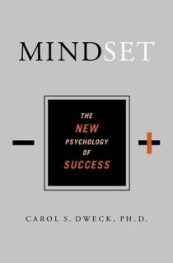

Mindset Matters!
Shenk, David, 2010. The Genius in All of Us: Why Everything You've Been Told About Genetics, Talent, and IQ Is Wrong. New York: Doubleday
Dweck, Carol, 2006.
Mindset: The New Psychology
of Success. New York:
Random House Publishing

Slide 59
Two Different Mindsets
About Intelligence
Fixed Mindset
Intelligence is static
You have a certain amount of it
Growth Mindset
Intelligence can be developed
You can grow it with actions
Dweck, Carol (2006) Mindset: The New Psychology of Success.
New York: Random House Publishing

Slide 60
Responses to Many Situations are Based on Mindset
 | Fixed Mindset Response | Growth Mindset Response
Challenges | Avoid | Embrace
Obstacles | Give up easily | Persist
Tasks requiring effort | Fruitless to try | Path to mastery
Criticism | Ignore it | Learn from it
Success of Others | Threatening | Inspirational

Slide 61
Which mindset about intelligence do you think most students have?
Fixed
Growth

Slide 62
Which mindset about student intelligence do you think most faculty have?
Fixed
Growth

Slide 63
Email from a General Chemistry Student
with a Fixed Mindset
“…Personally, I am not so good at chemistry and unfortunately, at this point my grade for that class is reflecting exactly that. I am emailing you inquiring about a possibility of you tutoring me.”
April 6, 2011
------------------------------------------------------------------------------------------------------------------------------------
“I made a 68, 50, (50), 87, 87, and a 97 on my final. I ended up earning a 90 (A) in the course, but I started with a 60 (D). I think what I did different was make sidenotes in each chapter and as I progressed onto the next chapter I was able to refer to these notes. I would say that in chemistry everything builds from the previous topic.
May 13, 2011
  Semester GPA: 3.8

Slide 64
Changes Faculty Have Made that Improved Learning and Performance
Present one 50-minute session on metacognition, Bloom’s Taxonomy, and the Study Cycle (Chemistry Professor at Middle Tennessee State University)
Provide learning strategies information to students after Test 1, and tell them about mindset
(Psychology Professor at Southern Crescent Technical College)
Increase the frequency of tests from three per semester to biweekly (Mathematics Professor at Miles College)
Teach students how to read (Chemistry Professor at LSU)
Have students determine their learning style preference and write reflection on how they will use the information (Entomology Professor at LSU)

Slide 65
The Experience of One Professor at Miles College
Beliefs I had to change:
Math is a gatekeeper course.
You MUST get through ALL the material before the semester is over.
I was skeptical about metacognition.
Why I changed
To avoid overwhelming students
To allow time to teach the Study Cycle

Slide 66
Professor Charles N. Morris III:
Miles College Faculty Member of the Year
What changes I made:
  I now incorporate study skills into my instruction.
  I gave repeated reminders of, and briefly practiced, The Study Cycle.
  I started stripping course material down to the bare minimum, avoiding repetition when possible.
  I gave smaller tests, and tested more frequently.
  I used the test as a teaching device. Students who choose can get make up points by resubmitting missed questions on tests along with written solutions with correct procedures.
Why I am not skeptical of metacognition:
  The results!

Slide 67
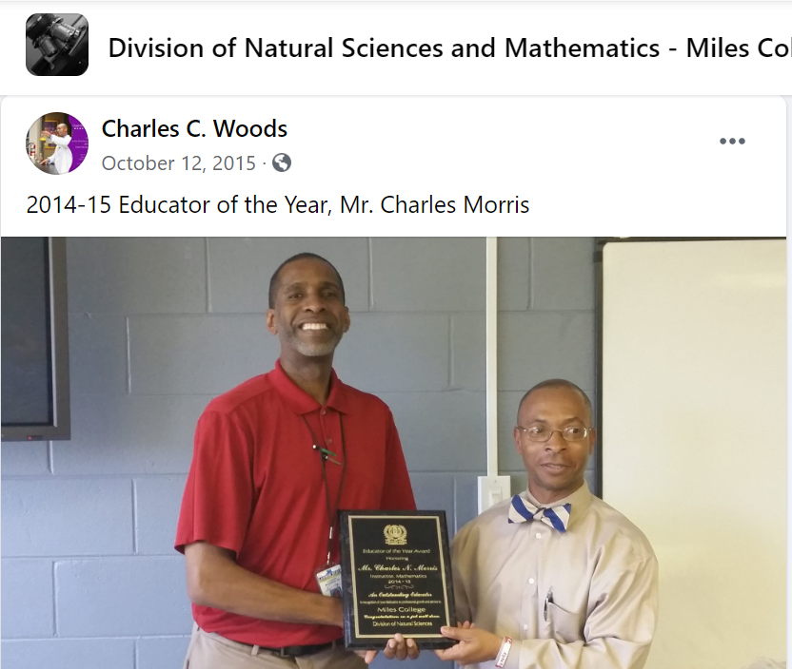

Slide 68
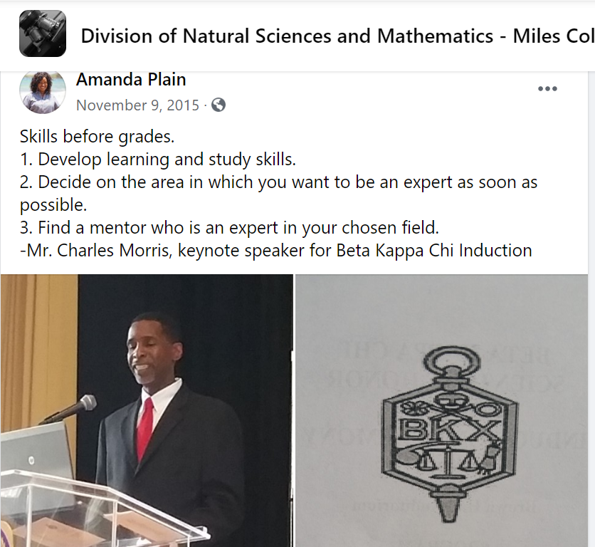

Slide 69
LSU Analytical Chemistry Graduate Student’s Cumulative Exam Record
2004 – 2005
9/04 Failed
10/04 Failed
11/04 Failed
12/04 Failed
1/05 Passed
2/05 Failed
3/05 Failed
4/05 Failed
2005 – 2006
10/05 Passed
11/05 Failed
12/05 Passed best in group
1/06 Passed
2/06 Passed
3/06 Failed
4/06 Passed last one!
5/06 N/A
Began work with CAS and the Writing Center in October 2005

Slide 70
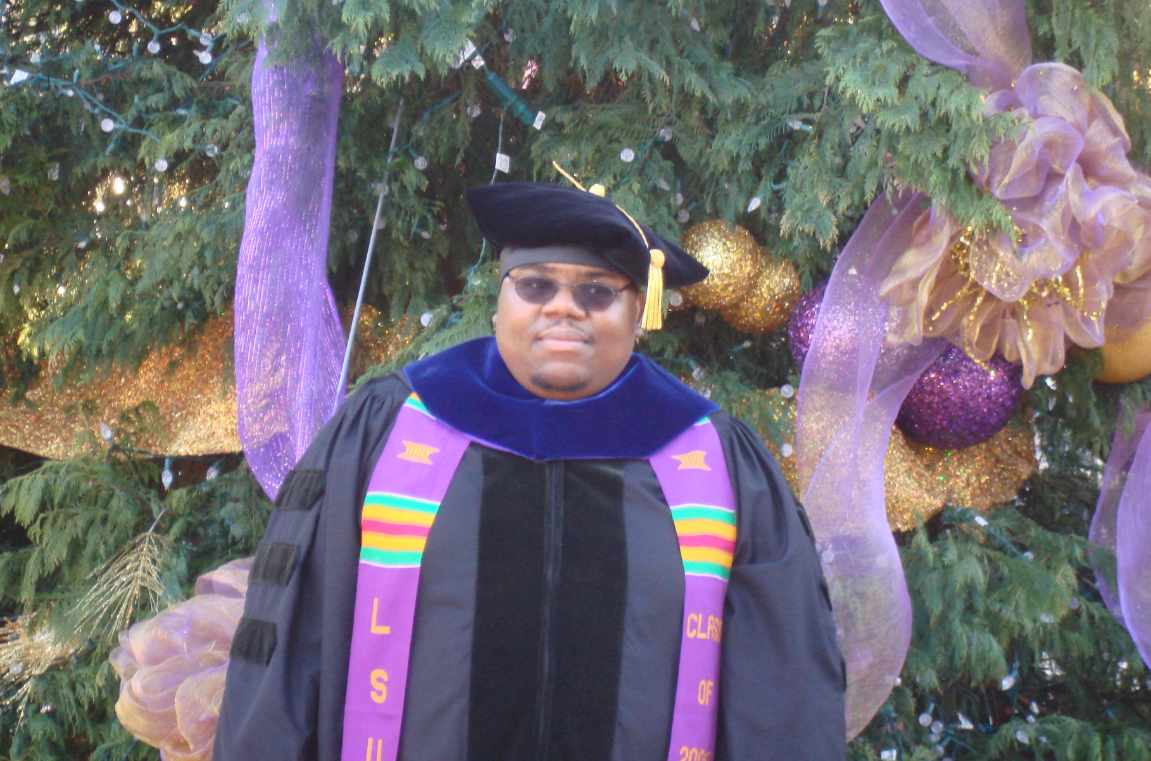
Dr. Algernon Kelley, December 2009

Slide 71
From a Xavier University student to Dr. Kelley in Fall 2011
Oct. 17, 2011
Hello Dr. Kelley. … I am struggling at Xavier and I REALLY want to succeed, but everything I've tried seems to end with a "decent" grade. I’m not the type of person that settles for decent. What you preached during the time you were in Dr. Privett's class last week is still ringing in my head. I really want to know how you were able to do really well even despite your circumstances growing up. I was hoping you could mentor me and guide me down the path that will help me realize my true potential while here at Xavier. Honestly I want to do what you did, but I seriously can't find a way how to. Can I please set up a meeting with you as soon as you’re available so I can learn how to get a handle grades and classes?
Oct. 24, 2011
Hey Dr. Kelley, I made an 84 on my chemistry exam (compared to the 56 on my first one) using your method for 2 days (without prior intense studying). Thanks for pointing me in the right direction. I’ll come by your office Friday and talk to you about the test.
Nov 3, 2011
Hey Dr. Kelley! I have increased my Bio exam grade from a 76% to a 91.5% using your system. Ever since I started your study cycle program, my grades have significantly improved. I have honestly gained a sense of hope and confidence here at Xavier. My family and I are really grateful that you have taken time to get me back on track.

Slide 72
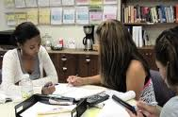
Conclusion
We can significantly increase student success by…
teaching students how to learn
making learning visible
not judging student potential on initial performance
encouraging students to persist in the face of initial failure
encouraging the use of metacognitive tools for deep and integrative learning

Slide 73
Additional References
Bruer, John T. , 2000. Schools For Thought: A Science of Learning in the Classroom. MIT Press.
Bransford, J.D., Brown, A.L., Cocking, R.R. (Eds.), 2000. How people learn: Brain, Mind, Experience, and School. Washington, DC: National Academy Press.
Christ, F. L., 1997. Seven Steps to Better Management of Your Study Time. Clearwater, FL: H & H Publishing
Cromley, Jennifer, 2000. Learning to Think, Learning to Learn: What the Science of Thinking and Learning Has to Offer Adult Education. Washington, DC: National Institute for Literacy.
Ellis, David, 2014. Becoming a Master Student. Boston: Cengage Learning.
Hoffman, Roald and Saundra Y. McGuire. (2010). Learning and Teaching Strategies. American Scientist , vol. 98, pp. 378-382.
Nilson, Linda, 2004. Teaching at Its Best: A Research-Based Resource for College Instructors. Bolton, MA: Anker Publishing Company.
Pierce, William, 2004. Metacognition: Study Strategies, Monitoring, and Motivation.
http://academic.pg.cc.md.us/~wpeirce/MCCCTR/metacognition.htm

Slide 74
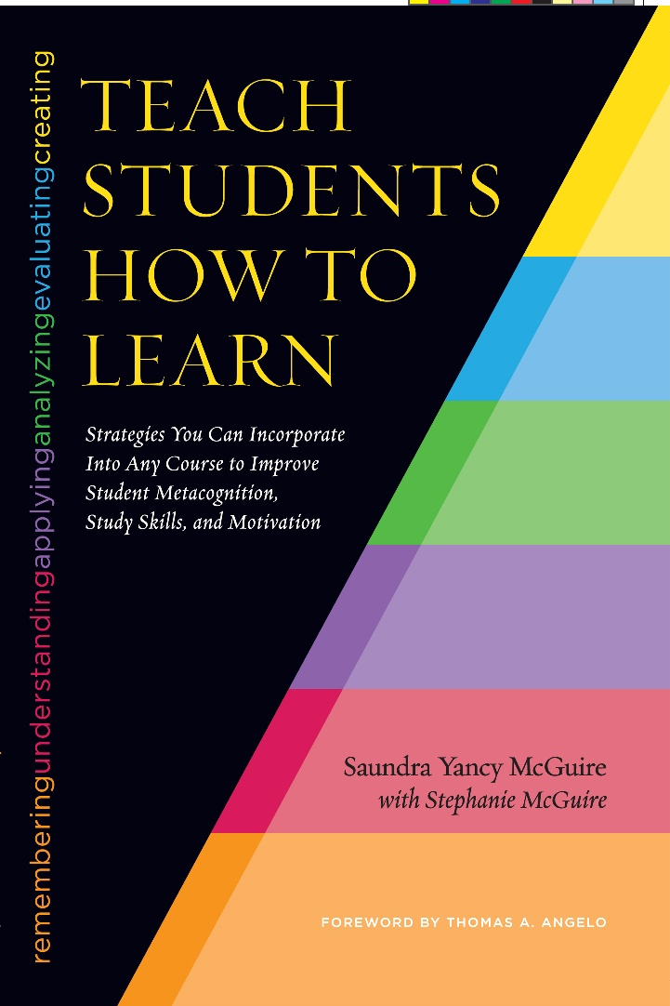
A Faculty Resource
McGuire, S.Y. (2015). Teach Students How to Learn: Strategies You Can Incorporate into Any Course to Improve Student Metacognition, Study Skills, and Motivation. Sterling, VA: Stylus

Slide 75
The Book for Students
McGuire, S.Y. (2018). Teach Yourself How to Learn: Strategies You Can Use to Ace Any Course at Any Level. Sterling, VA: Stylus

Slide 76
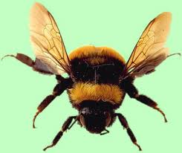

Slide 78
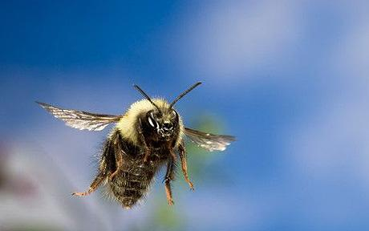

Slide 79
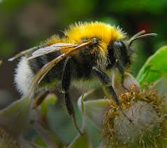
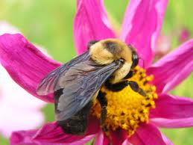
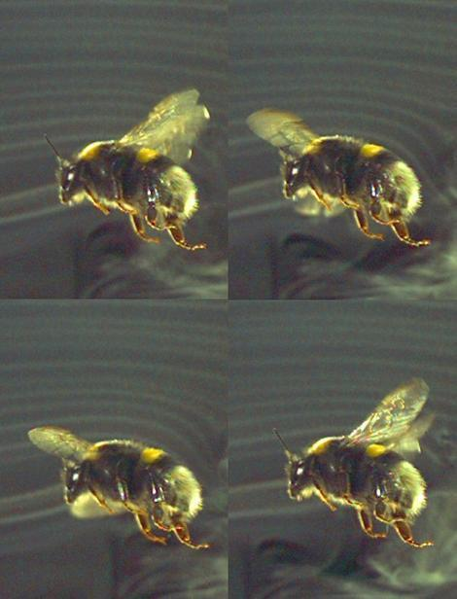
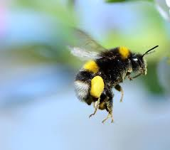
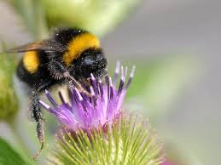
Why the Bumblebee CAN fly…

Slide 81
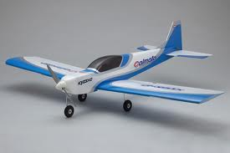
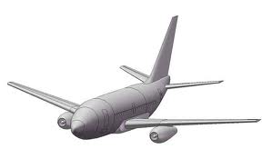



Slide 82
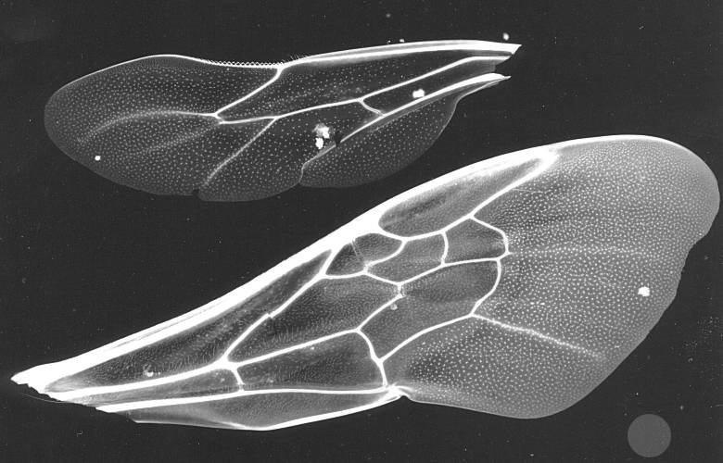

Slide 84
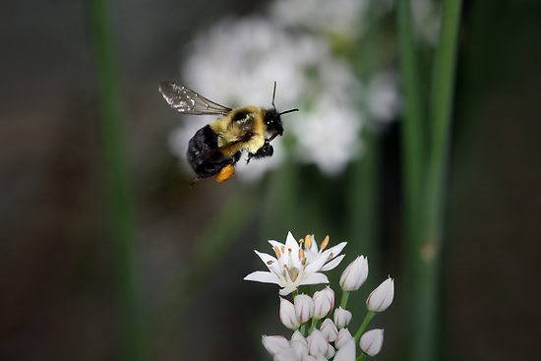

Slide 85

Go Lions!!!

